Slide 1
Real Estate management system
Abhishek Yadav B170442CS
Adarsh Kumar B170414CS
Yash Bhardwaj B170287CS

Slide 2
Introduction
Real Estate Management System is a web application built using HTML, CSS and some amount of JavaScript for front-end and PHP as server-side scripting language. MySQL is used for managing database.
Now a days most real estate companies are still using traditional way to manage data through books or file systems like excel sheets.
This project aims at developing an efficient info management system for real estate industry, client management and maintaining theproperty listings.
Through this software buyers as well as sellers can interact to each other easily and more reliably.

Slide 3
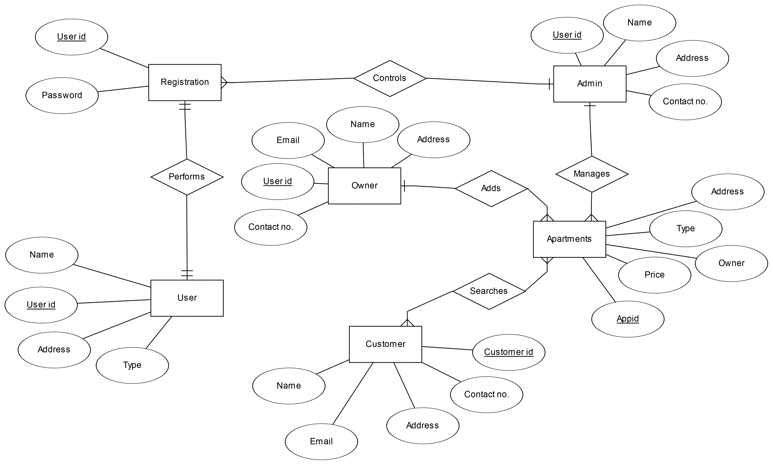
E-r Diagram

Slide 4
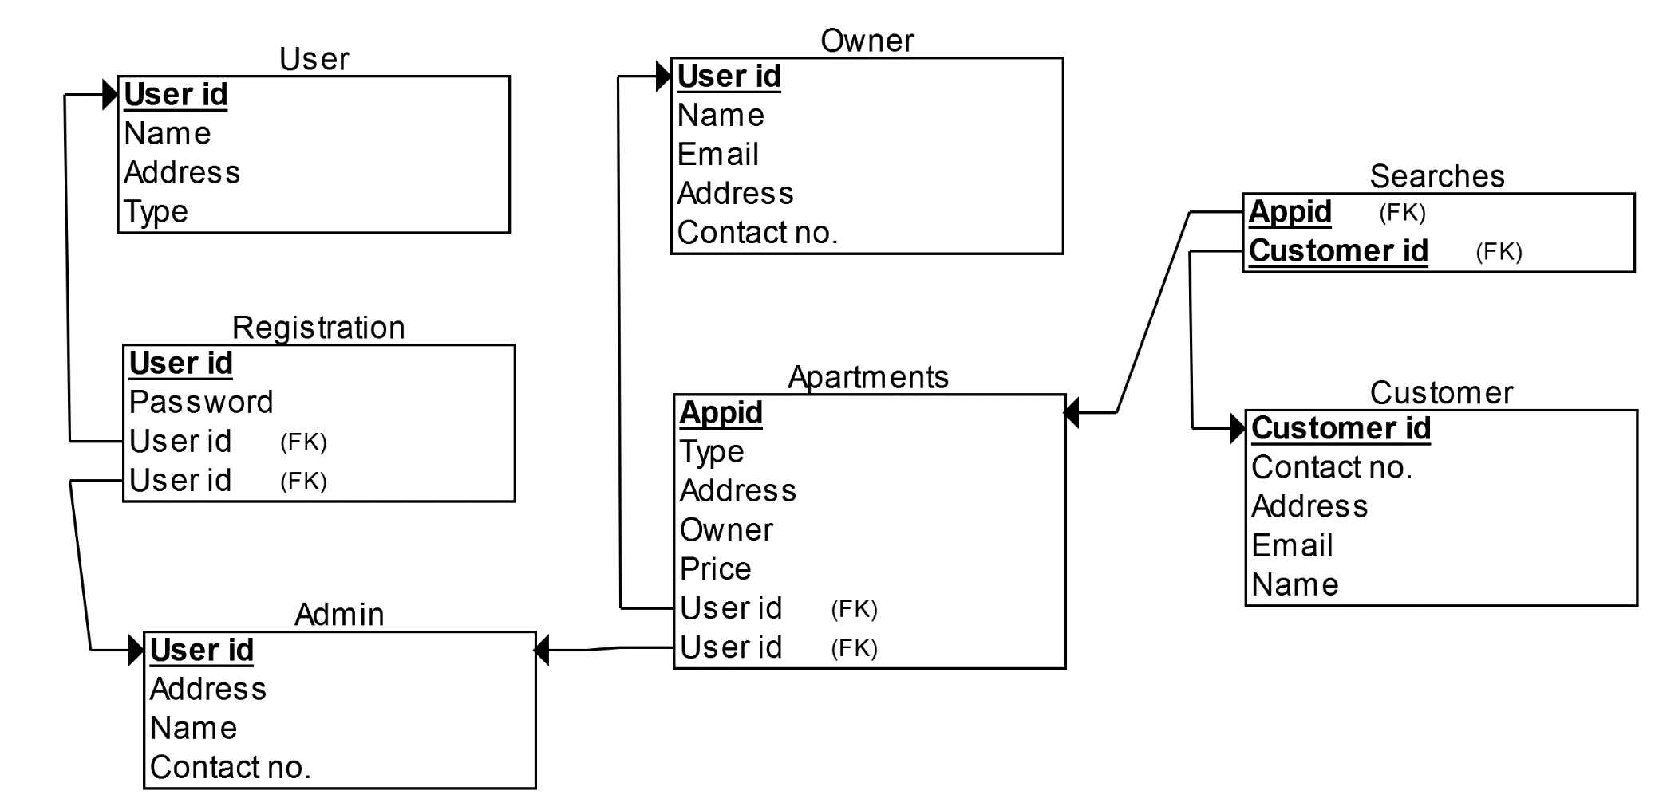
Database schema

Slide 5

Types of users
Seller
Buyer
Admin(super user)

Slide 6
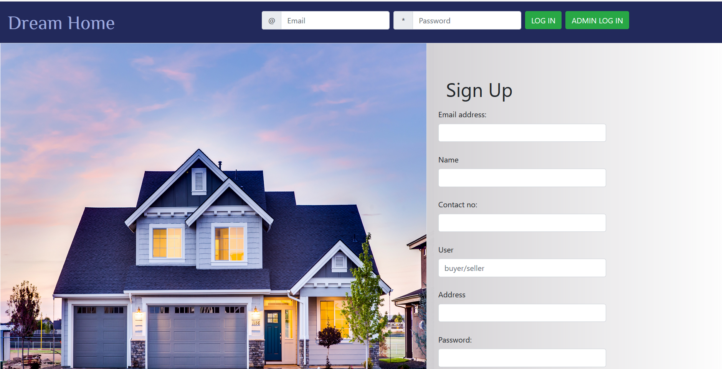
Welcome page
Welcome page contains following buttons to redirect it to appropriate page:-
User Sign Up
User Login
Admin Login

Slide 7
Admin

Slide 8
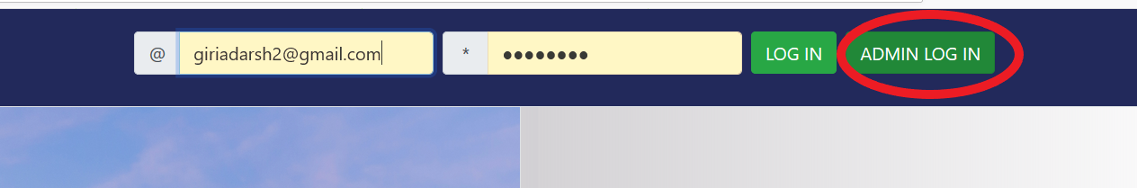
Admin login
Admin username and password are given by developers only.
They can directly login to enter into the appropriate page.

Slide 9
Admin functionalities
Admin can add apartments in the account of a user registered in his/her company.
Admin can view the apartments in the account of a user registered in his/her company.
Admin can view the suggestions given by a user registered in his/her company.
Admin can deregister a user from his/her company if required.
Admin can view the details of a user registered in his/her company.

Slide 10
Users

Slide 11
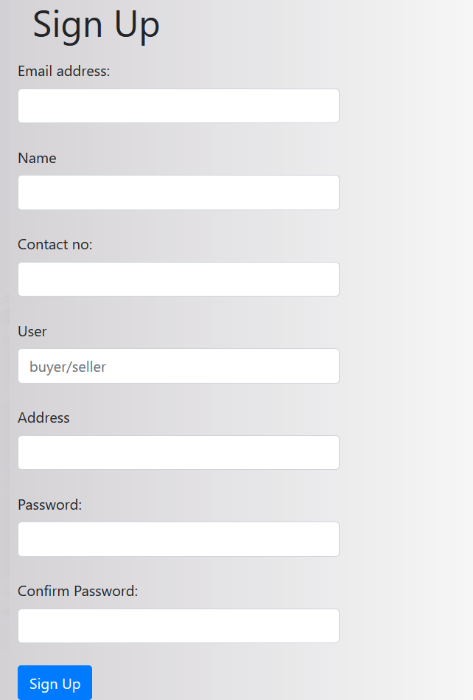
User sign up page
Registration page consists of:
Email id(Primary Key for User)
Name
Contact no.
User type(seller/buyer)
Address
Password field
Confirm password field

Slide 12
Constraints on user Registration
Email id should contain @ format.
Contact no. should be of 10 digits.
User should be either seller or buyer.
Password must be minimum of 8 character long.

Slide 13

User login page
Login page consists of:
Email ID
Password field
If email id is not registered or if password is incorrect, appropriate error message will be displayed.

Slide 14

User Types
Users are of two types:-
Sellers
Buyers

Slide 15
Seller functionalities
They can add apartments to sell.
A seller can also buy apartment from his/her account.
They can request apartment to buy.
They can give suggestions to admin by contacting them.

Slide 16
Buyer functionalities
They can search apartments from the list.
A buyer can buy apartment from his/her account.
They can request apartment to buy.
They can give suggestions to admin by contacting them.

Slide 17
Thank you

